Slide 1
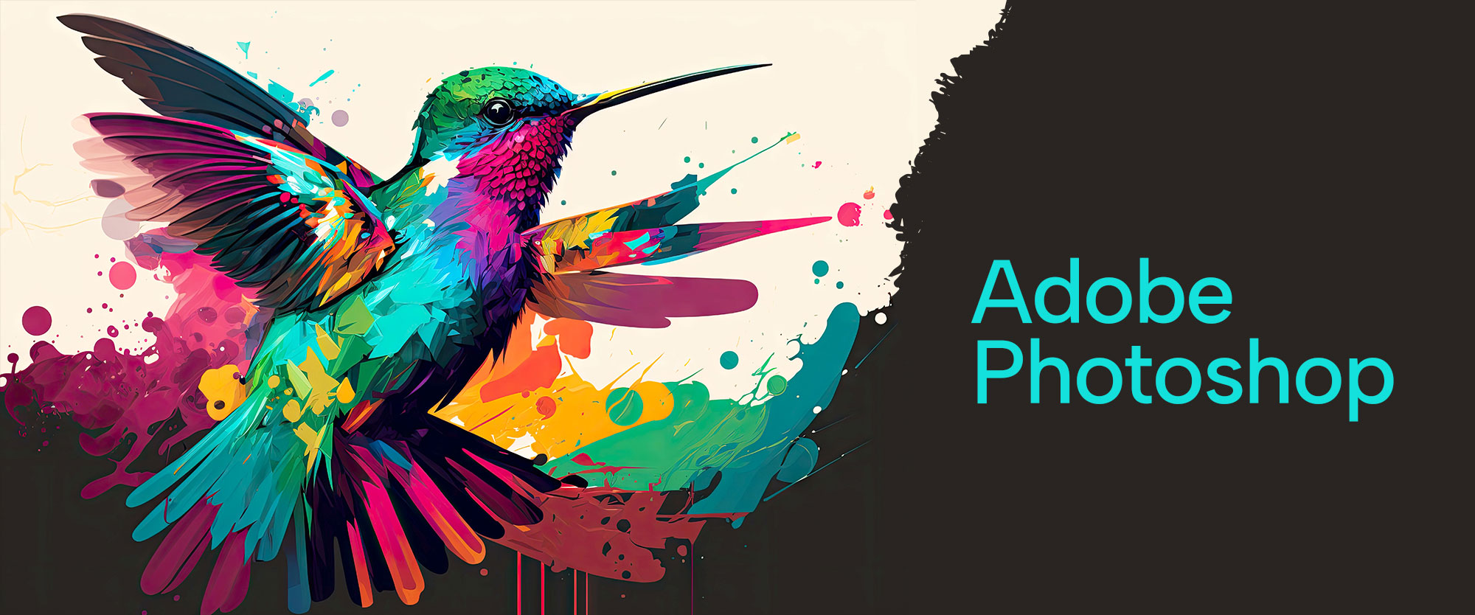

Slide 2
About today…
Crop, Rotate, Resize
Basic drawing tools
Rectangle
Rounded Rectangle
Ellipse
Polygon
Line

Slide 3

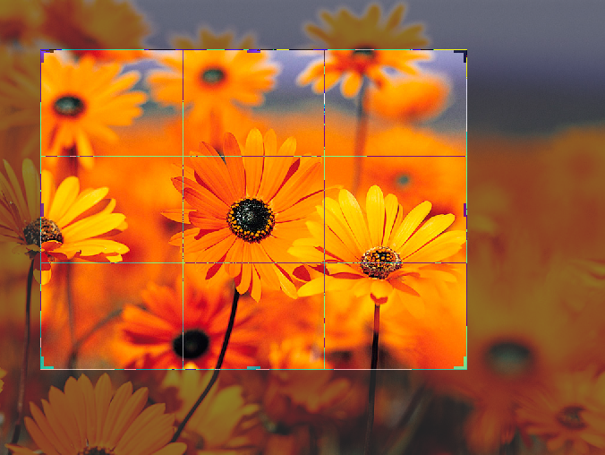
Crop Tool
Cut out unwanted areas from an image using the Crop tool

Slide 4
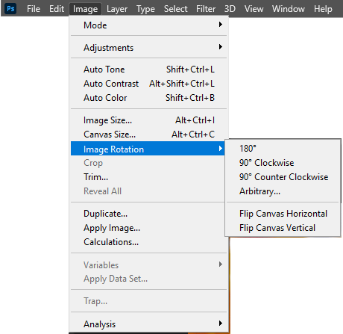

Rotate Tool

Slide 5
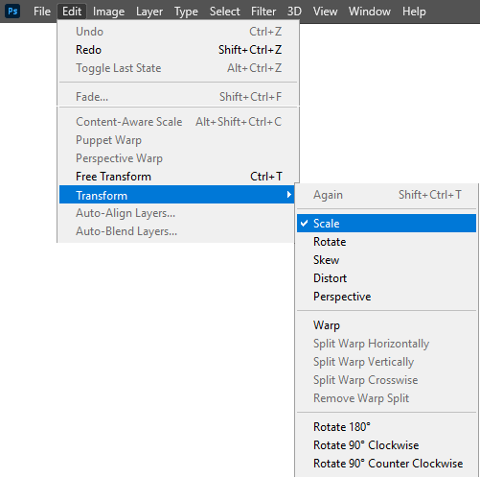
Resize Tool

Slide 6


Rectangle Tool
Used to draw rectangle

Slide 7


Rounded Rectangle Tool
Used to draw rounded rectangle

Slide 8


Ellipse Tool
Used to draw elliptical shape

Slide 9


Polygon Tool
Used to draw polygon shape

Slide 10


Line Tool
Used to draw line shape

